Slide 1

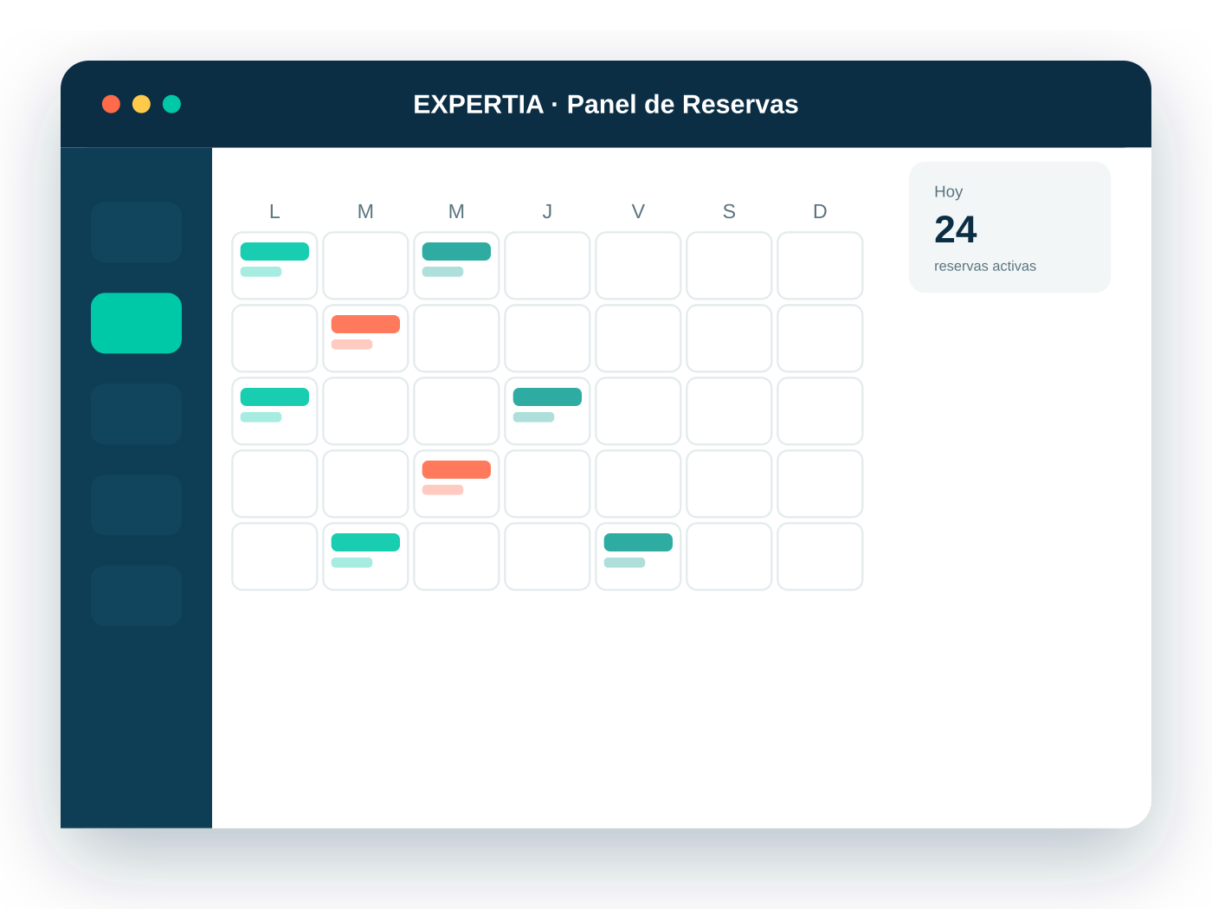
FINAL PRESENTATION · PHASE 3
EXPERTIA
Business Management Platform
Multi-tenant SaaS booking and management platform, easy to set up for any service business, with an AI scheduling assistant.
Team Maximiliano Díaz · Genesis Cáceres · Alberto Rincón
Faculty advisor Félix Cifuentes
Computer Engineering · Duoc UC · November 2026
Notes:
Cover. Introduce the project, the team and the faculty advisor.

Slide 2




Project team
TEAM
MD
GC
AR
Maximiliano Díaz
Genesis Cáceres
Alberto Rincón
PROJECT MANAGER
SENIOR FUNCTIONAL ANALYST
FULL STACK DEVELOPER
RESPONSIBILITIES
RESPONSIBILITIES
RESPONSIBILITIES
Phased strategy and sprint plan
Requirements and user stories
Angular 18 frontend
Team and Jira organization
Acceptance criteria per sprint
Django REST backend
Repository setup
Functional validation of each story
Docker environment and CI pipeline
Documentation in Confluence
Quality and coverage strategy
Gemini conversational assistant
Progress and risk tracking
Functional documentation
Functional mockup and prototype
Notes:
Team roles: project manager, senior functional analyst and full stack developer.

Slide 3



From problem to solution
PROJECT DESCRIPTION
Problem or pain point
Proposed solution
Small and mid-sized service businesses
Expertia multi-tenant SaaS
Lost customers due to manual booking
Scheduling errors and double bookings
No operational visibility of the business
Versatile
One Service ↔ Resource model for salons, clinics and group classes
Simple
Industry templates: set up the business by answering questions
Transparent
The market forces a trade-off: no competitor (AgendaPro, Calendly, Booksy, Fresha) combines versatility, simplicity and transparent pricing.
Basic and Pro plans, no per-booking fees
AI-powered
Customers book by chatting with an assistant (Gemini)
Notes:
Problem and value proposition, based on the project context and the competitive benchmark.

Slide 4

General and specific objectives
OBJECTIVES
GENERAL OBJECTIVE
Develop a SaaS booking and appointment platform that is easy to set up for any service business, without the complexity of existing alternatives.
1
✓ ACHIEVED
2
✓ ACHIEVED
3
✓ ACHIEVED
Manage the project with Jira and Confluence
Design a generic business model
Bring AI into scheduling
49 issues tracked across 5 sprints and 19 documentation pages with change control.
A single Service ↔ Resource model covers individual professionals, composite resources and group services.
A Gemini assistant that checks availability, recommends a professional and completes the booking.
Notes:
Specific objectives defined in the proposal. Evidence of completion comes from Jira and Confluence.

Slide 5


Project scope and limitations
SCOPE
In scope (MVP)
Limitations
7 modules IAM, Tenant, Catalog, Booking, Notifications, Reporting and AI Assistant
No online payments or public marketplace
Email-only notifications (no WhatsApp or SMS)
Responsive web, no native mobile app
No password recovery (post-MVP)
End customers book without an account
Gyms supported by the model, not demonstrated
No AWS deployment: demo in containers and on video
2 pilot verticals Beauty salon and medical clinic or practice
4 roles Super Admin, Business owner, Staff and End customer
Basic and Pro plans The AI assistant is available on the Pro plan only
Public landing page Free 14-day demo request
Notes:
“Won’t have” scope from Product Backlog v2.8 and decision RES-009 of October 14.

Slide 6







Work methodology: Scrum with full traceability
METHODOLOGY
01
02
03
04
05
›
›
›
›
Backlog
Planning
Development
Review
Done
As a / I want / So that stories, MoSCoW and Fibonacci story points
~2-week sprints with defined acceptance criteria
Commits on develop tagged with the Jira story key
Pull Request to main, peer review and green CI
Story moved to “Done” and documented in Confluence
Jira
Confluence
GitHub
Sprint 0 + 4 sprints
3-person team, ~2-week sprints
Backlog, sprints and board · CAPDC project
Living documentation · EXPERTIA-CAP26 space
Code, Pull Requests and GitHub Actions
Notes:
Scrum methodology. Each story is traceable from Jira to the commit, the Pull Request and Confluence.

Slide 7
Schedule and completion at close
TIMELINE
SEP
OCT
NOV
Today · Nov 9
Sprint 0
Proposal and mockup
Closed Oct 14
Sprint 1
Foundation · 39 SP
Closed Oct 14
Sprint 2
Catalog · 39 SP
Closed Oct 25
Sprint 3
Booking + AI · 76 SP
Closed Nov 7 · plan Nov 8
Sprint 4
Wrap-up · 19 SP
Closed Nov 8 · plan Nov 12
100%
completion
173 of 173 planned SP
29/29
stories Done
All 7 epics complete
48/49
issues closed
Pending: Deliverable 3 (CAPDC-47)
4 days
ahead
Sprint 4: plan Nov 12, closed Nov 8
Notes:
Bars show the actual start and close dates of each sprint in Jira. Sprints 3 and 4 closed before their planned dates; Sprint 4 started on Nov 4, overlapping the close of Sprint 3.

Slide 8




Software architecture: modular monolith
ARCHITECTURE
7 MODULES (BOUNDED CONTEXTS) + SHARED KERNEL
FRONTEND
IAM
Tenant
Catalog
Booking ★
Angular 18 · SPA
Notification
Reporting
Assistant
Shared Kernel
BACKEND
LAYERS PER MODULE
Django REST · Python 3.12
API
Application
Domain
Infrastructure
Assistant powered by Google Gemini Flash
Via LlmProviderPort: the LLM can only call existing Catalog and Booking services (tool calling).
DATA
PostgreSQL 16
ADR-001 Modular monolith
ADR-002 Ports
ADR-004 Django
ADR-005 LLM
Everything runs on Docker Compose · REST API with JWT
Notes:
Modular monolith (ADR-001) with port-based communication (ADR-002). Booking is the core domain. AWS was set aside on October 14: everything runs on local Docker.

Slide 9




Data model: 13 tables in PostgreSQL
DATA MODEL
Identity and business
Catalog
Booking (core)
UUID
as primary key
tenants
servicios
reservas
usuarios
recursos
reserva_recurso
EXCLUDE
miembros_staff
servicio_recurso
GiST: a resource can never be double-booked
disponibilidad_recurrente
excepciones_disponibilidad
tenant_id
AI Assistant
Notifications
isolates each business’s data
conversaciones
notificaciones
Service ↔ Resource is many-to-many: it enables the generic model (1 resource at a salon; room + equipment + professional at a clinic).
BCNF
mensajes
with one documented denormalization
Notes:
Database design v2.0. The EXCLUDE constraint with a GiST index guarantees at engine level that a resource has no overlapping bookings. Table names are kept as implemented in Spanish.

Slide 10









Technologies used
TECHNOLOGIES
Angular 18
Django REST
PostgreSQL 16
Docker Compose
TypeScript SPA frontend
REST API · Python 3.12
pgcrypto and btree_gist
Full containerized environment
Google Gemini
JWT
GitHub Actions
pytest
Flash model for the assistant
Authentication with simplejwt
CI: build, tests and lint
Backend tests · 80% threshold
Jasmine + Karma
Ruff
Jira
Confluence
Headless frontend tests
Lint and architecture rules (import-linter)
Scrum, backlog and sprints
Living documentation
Notes:
Current stack per ADR-004 (Django) and the local development environment. GitHub hosts the private repository.

Slide 11
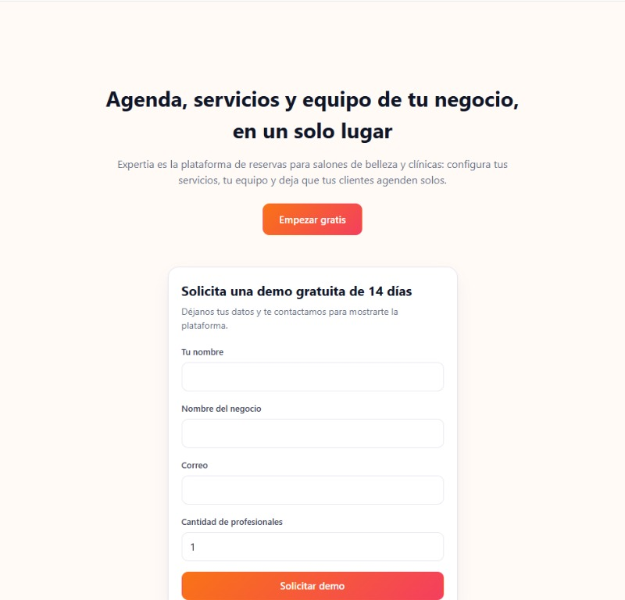
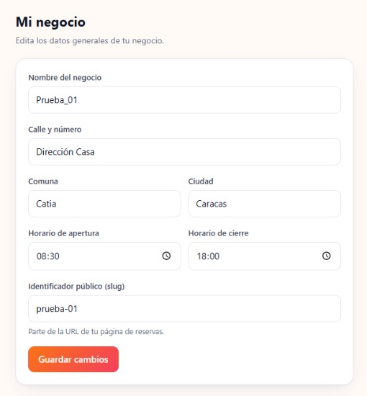
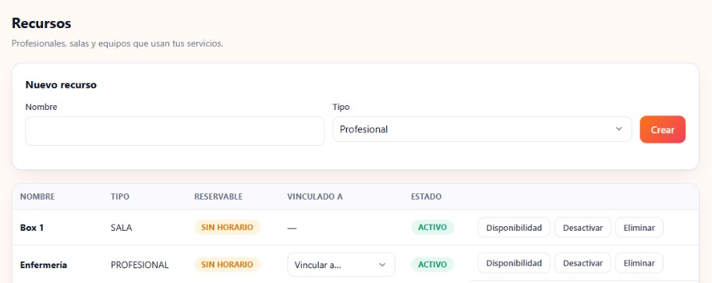
Results achieved
RESULTS
173/173
29/29
7/7
99.6%
story points completed
stories in Done
modules implemented
backend coverage measured Oct 7
Story points completed per sprint
Solution built
Landing and demo
My business
Resources
Notes:
Jira data as of November 9. Coverage is the latest recorded measurement (CAPDC-40); update it before presenting. Screenshots show the Spanish UI.

Slide 12





Challenges faced during development
LESSONS LEARNED
Scope +42%
Earlier schedule
Stack change
The AI assistant raised Must-have scope from 92 to 131 SP.
Sprint 1 moved from Oct 17 to Sep 23 with design stages still open.
Spring Boot was replaced by Django REST (ADR-004).
✓ Full Epic 7 delivered in Sprint 3, chatbot kept intact.
✓ Setup, CI and quality became Sprint 1 tasks.
✓ Documents and architecture rules migrated to Django.
Cloud deployment
Demanding Sprint 3
Jira–Confluence gap
On Oct 14, AWS was set aside to prioritize MVP functional scope.
76 SP (44% of total): booking and assistant in two weeks.
Duplicate keys and an unrecorded Sprint 0.
✓ Demo on Docker containers; AWS kept as a future improvement.
✓ Acceptance criteria set upfront; finished Nov 7.
✓ Change log with traceability by date and version.
Notes:
Challenges taken from the Confluence change log and the Product Backlog risk note.

Slide 13


Questions from the panel
and live demo
›
›
›
›
Landing and sign-up
Catalog and resources
Booking with the assistant
Email confirmation
Dashboard and report
Demo walkthrough · EXPERTIA · Business Management Platform
Notes:
Suggested live demo walkthrough.

